Slide 1
Mechanism of Recombination, con’t A solution to the gene targeting problem: CRISPR/Cas9 Introduction to budding yeast
Doug Bishop Lecture 3
GAMO
GENE314/BIOS21236

Slide 2
Homologous Recombination is a mechanism to repair DNA double strand breaks
DNA double strand break
(DSB)
recipient
donor
gene conversion
The chromosome that suffers the DSB receives information during recombination events

Slide 3
Unfinished business: converting hybrid DNA
recipient
donor
I showed these diagrams last time…
Notice that, in the crossover and non-crossover products,
only one of the two ssDNA strands of the recipient chromosome has undergone gene conversion. Normally, if hybrid DNA forms in a genetically marked region, both strands of the product undergo conversion. How does this occur?
D-loop formation
end extension
D-loop disruption
2nd end capture (annealing)
annealing
fill-in and ligation
double Holliday junction
fill-in and ligation
½ conversions
resolution
non-crossover
non-crossover
crossover

Slide 4
Mismatch Repair corrects errors made by DNA polymerase
Mismatched
base pair
MutSα (MSH2/MSH6) - recognizes mismatch
or 1 bp insertion/deletion mispairs
MutSβ (MSH2/MSH3) - recognizes 2-12 bp indel mispair
MutLα (MLH1/PMS2) - endonuclease activity-makes a nick on the newly synthesized strand
Exonuclease I - resects the nicked strand
excision
Polymerase δ/ε - perform DNA resynthesis
synthesis
Hoeijmakers, Nature 411, 366-374(2001)

Slide 5
Mismatch repair acts on recombination intermediates to convert ½ gene conversions to full gene conversions
Annealing step of SDSA
2nd end capture step of dHJ pathway
To detect gene conversion, a genetic marker must be included in a hybrid DNA tract.
If this occurs there will be at least one mismatched base pair (or an ssDNA insertion/deletion loop).
The mismatch repair
Machinery will recognize the mismatch and repair it.
This completes the gene conversion process.
Hybrid DNA
Hybrid DNA
A
A
C
C
G
G
C
excision
C
C
C
G
G
C
C
synthesis
G
G
C
C
G
G
C
C
An A/T base pair in the recipient chromosome is converted
to a G/C base pair with sequences derived from the donor
chromosome.

Slide 6
Gene Targeting
Target gene replaced by incoming DNA which contains a small or large change in sequence.
Homologous Recombination does the work of Gene Targeting
linear DNA fragment
Incoming (donor) DNA
left homology arm
right homology arm
chromosome
TARGET (recipient)DNA
linear DNA fragment
Incoming (donor) DNA
homologous recombination
chromosome
TARGET (recipient)DNA
chromosome
Incoming (donor) DNA

Slide 7
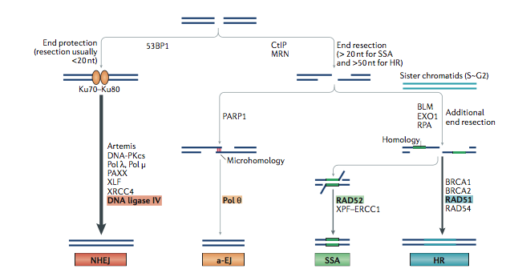
Non homologous end joining pathways c-NHEJ and TMEJ heal DNA breaks by ligation without being guided by a homologous chromosome
c-NHEJ
TMEJ
Two independent paths for ”illegitimate” joining of DNA ends
Notes:
7

Slide 8
Homologous recombination and non-homologous end-joining are two alternative mechanisms for repairing DNA double strand breaks.
NHEJ is very efficient in many types of cells. This causes major problems when one is trying to target a gene with a cloned DNA fragment.
When homologous recombination fails, TMEJ or c-NHEJ acts on the foreign DNA and at least one copy of that DNA may be inserted at a genomic locus other than that containing homology to the incoming DNA fragment.
In most organisms:
When foreign linear DNA is introduced into a cell that lacks a DNA break at a homologous site on a chromosome, that foreign DNA most often ends up being inserted randomly into the genome as a result of non-homologous end-joining activity.
incoming DNA
target
off-target site
happens to have suffered a DSB
end-joining
incoming DNA
off target insertion event

Slide 9
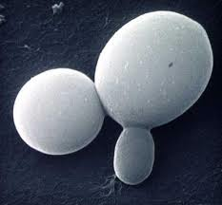
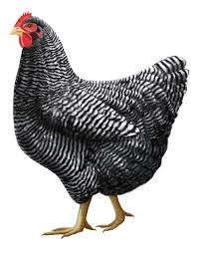
Budding yeast and the immortalized chicken B-cell line DT40 are exceptional with respect to gene targeting
For most targeting fragments, the fraction of yeast transformants and DT40 transfectants that turn out to be correctly targeted is over 50%--i.e homologous recombination between the targeting fragment and the target locus is efficient.
In human cells, flies, plants, nematodes, and many other organisms, the frequency of targeting was so low (often less than 1/1000) that the approach has been impossible or unfeasible.
Targeting efficiency is also low in mice, but special selection methods have been developed that allow one to identify rare events that result from homologous recombination-mediated gene targeting.

Slide 10
Exception to the rule concerning gene targeting ….”ends-out” targeting of a linear DNA fragment
chromosome
targeting DNA
The mechanism of ends-out
recombination is not well-understood,
but it is very likely to involve a complex resolution
step. Both strands of the chromosome
must be cleaved at the ends or within
the regions corresponding to the
homology arms of the fragment.
Why a mechanism of this type appears to occur efficiently in yeast and chicken B-cells, but not other cells, is not known.

Slide 11
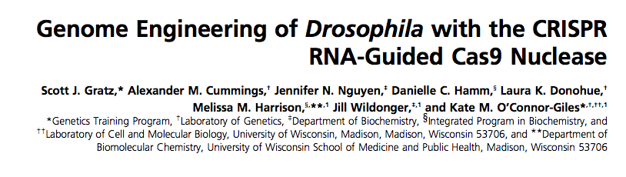
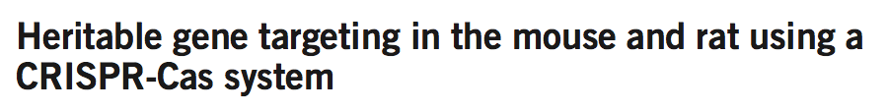
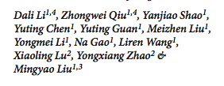
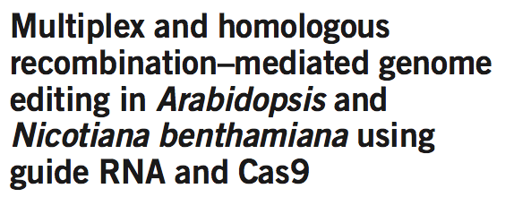
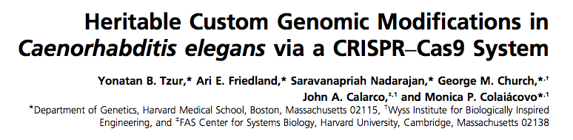


It is a new day

Slide 12
Why does a DSB on the chromosome stimulates gene targeting?
incoming (donor) DNA
The chromosome is intended to be the recipient in the homologous recombination event that is needed for gene targeting with a transfected DNA fragment.
For targeting work in most cell types, there needs to be a DNA double strand break at the locus on the chromosome that you wish to target. In addition, the recombination pathway, rather than the DNA end-joining pathway needs to act.
target
target
homologous
recombination
target

Slide 13
Ends-in targeting of a linear DNA fragment
chromosome
targeting DNA
D-loop formation
If an DSB is created on the chromosome, it becomes
primed to receive information from a homologous
DNA segment.
end extension
D-loop disruption
2nd end capture (annealing)
annealing
fill-in and ligation
fill-in and ligation
resolution
non-crossover gene conversion events

Slide 14
How to provoke a chromosome to be the recipient of information carried by a transfecting DNA fragment
Need a method to create a single DSB at the chromosomal location where a mutation is
to be targeted.
Need a specialized endonuclease that will only cleave at the desired location.
There are now 3 types of nucleases available that attempt to solve this problem.
ZFNs- Zing Finger Nucleases
TALENs-transcription activator-like effector nuclease
sgRNA/Cas9 (CRISPR/Cas9) complexes

Slide 15
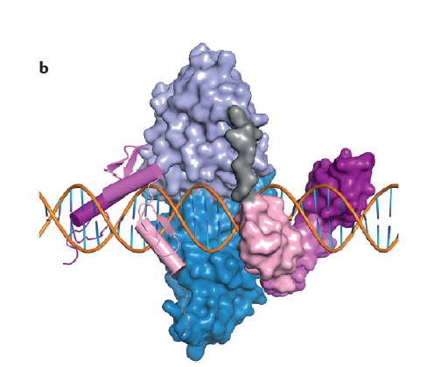
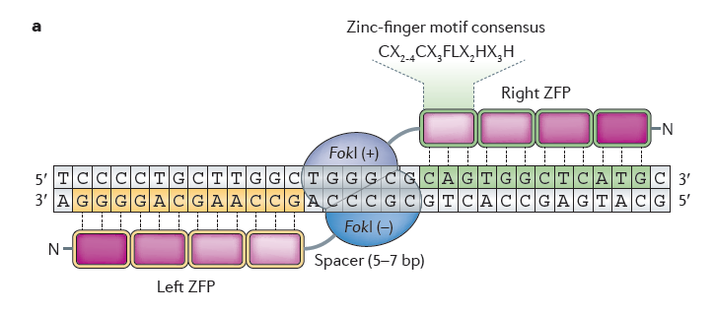
Zinc Finger Nucleases (ZFNs)
ZFP (zinc finger protein) domains bind to 3bp.
Combine 4 or more ZFPs to obtain a protein the binds to a specific DNA sequence.
Fok1 restriction enzyme has two separable domains. The DNA binding domain of the nuclease is removed and the nuclease domain is fused to a Zinc Finger domain to generate a chimeric protein that cleaves DNA adjacent to the specific DNA sequence bound by the ZF domain.
To avoid background activity that cleaves chromosomes at unintended sites, one can take advantage of the fact that each Fok1 domain only nicks a single strand of DNA. Use two ZFNs that target adjacent sequences.
Not all sequences can be targeted owing to limitations in the DNA binding activities of available ZFPs. Nonetheless, a suitable target sequence can be found every 100 bp on average.

Slide 16
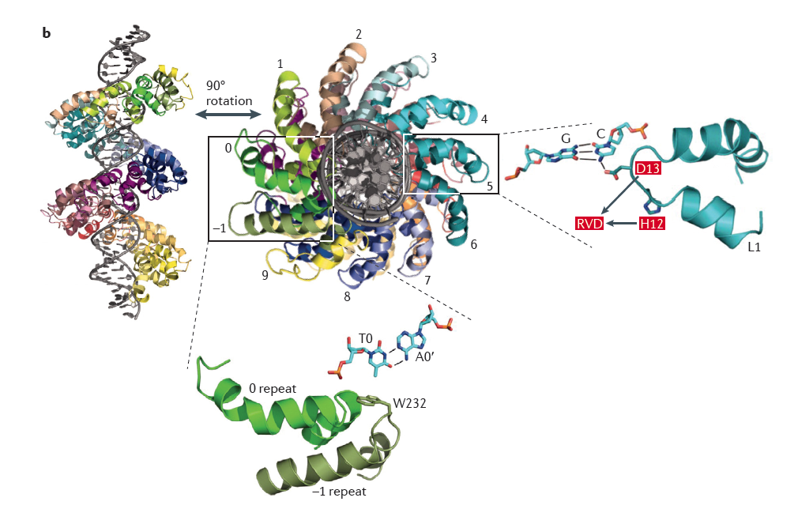
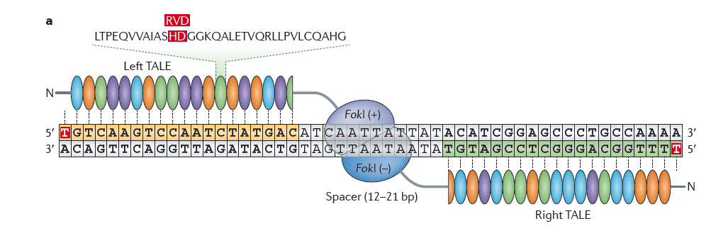
TALENs
TALEN=transcription activator-like effector nuclease
Similar to ZFNs in that one engineers a DNA sequence-specific nuclease by connecting a nuclease to a protein binding domain for a specific sequence.
In this case each domain recognizes a single base. Thus there are 4 coding domains that are spliced together in an order that corresponds to the target DNA sequence.
Fok1 endonuclease is used to make the actual cleavage, as in the ZFN strategy.
Problem is that each domain is over 34 aa and one needs about 25 domains to target Thus, the DNA constructs that code these engineered proteins are big (2.5 kb) and the coded protein tends to be unstable.

Slide 17
Major shortcoming of ZFNs and TALENs
Must engineer a new nuclease (protein) for each site in the genome you which to target.
Extensive optimization and evolution of newly-constructed nucleases is often required to obtain efficient and specific DNA breaks.
Thus, these are not feasible methods for high throughput gene targeting. Nor are they practical for everyday use by labs that want to target a variety of genomic loci.
Each engineered nuclease costs a lot of time and money.
Commercially available ZFNs are very expensive.

Slide 18
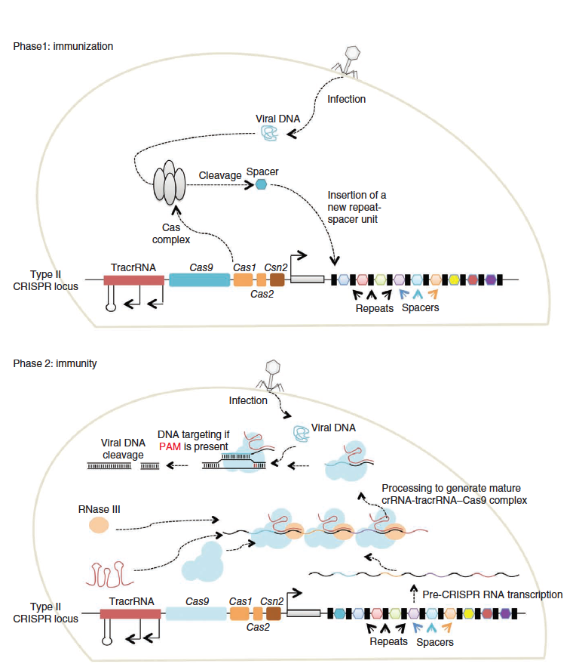
CRISPR/Cas9 is an immune system for bacteria and archaea
The bacterial genome contains a locus that codes for the Cas9 protein and also has a gene for TracrRNA (Transactivating CRISPR RNA).
Flanking this locus is the CRISPR region of clustered regularly interspaced short palindromic repeats
The “spacer” regions in between these repeats are critical for immunity.
Infecting bacteriophage (virus) DNA is cut into small pieces and these pierces are inserted at the CRISPR locuss in the genome.
The CRISPR region is transcribed into a long RNA which binds Cas9 and the anneals to the TracrRNA creating RNA duplexes.
The RNA duplexes are processed to yield mature crRNA-Cas9-TracrRNA complexes.
These complexes cleave phage DNA upon the next infection thereby protecting the cell from the phage.
Streptococcus pyrogenes

Slide 19
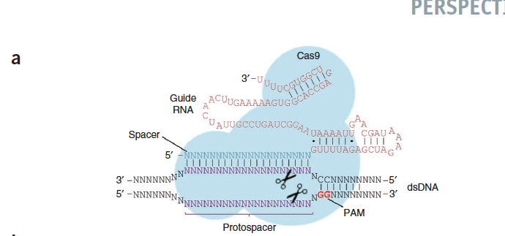
Engineering to make sgRNA/Cas9 work in human cells
•Codon optimization of cas9 gene to promote high levels of Cas9 protein expression. A nuclear localization signal was added for use in eukaryotes.
•Tge TracrRNA sequence is fused to the 3’ end of the region containing the guide RNA sequence (i.e. the sequence that will target the DNA break on the chromosome).
Cas9 contains two different nuclease domains, a RuvC-like and an HNH family nuclease domain. Each nuclease domain cleaves a DNA single strand as shown by the scissors in the cartoon.
TracrRNA region
guide RNA region
PAM (protospacer adjacent motif)
Required for binding of
sgRNA/Cas9 to target dsDNA
Target dsDNA sequence

Slide 20
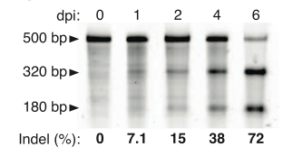
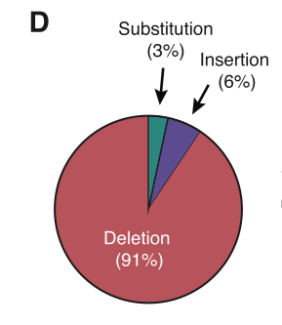
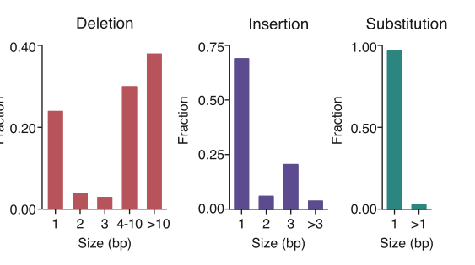
Efficient generation of DNA double strand breaks by sgRNA
Expression of an sgRNA + Cas9 creates a deletion mutant at the expected position.
Gel shows cleavage of the target sequence following expression of Cas9 and a specific sgRNA. (No targeting fragment used in this experiment).
Deep sequencing of the locus showed that the sgRNA directed a range of mutations—mostly deletions, but some insertions and substitutions as well. Insertions and substitutions are likely to reflect the activity of a polymerase called Pol-Theta which is coded for by the PolQ gene.

Slide 21
Two ways to use CRISPR/Cas9 to generate targeted mutations
Targeted deletions
(non-homologous end-joining)
VERY EFFICIENT (>50%)
Targeted insertions
(homologous recombination)
Efficiency varies 1-30%
x
x
gRNA/Cas9
gRNA/Cas9
[]
need only design sgRNA
need sgRNA + targeting fragment

Slide 22
Major Unsolved Problem with CRISPR/Cas9
x
x
chromosome I
chromosome II
chromosome III
desired event
chromosome I
chromosome II
chromosome III
However, these bad things can also happen!
non-homologous
(illegitimate)
integration
Small
deletion
translocation
large deletion
[]
chromosome I
chromosome II
chromosome III

Slide 23
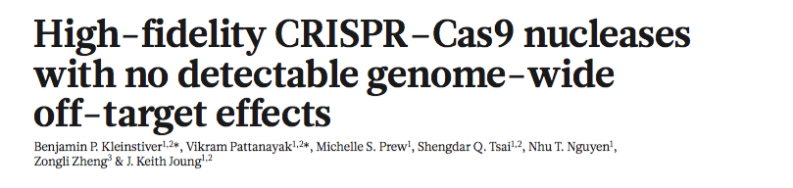

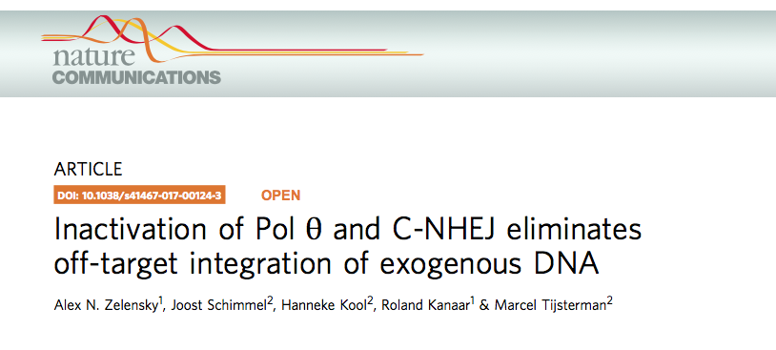
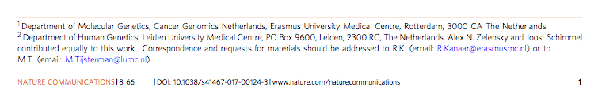
Recent advances
ADD pol theta paper

Slide 24
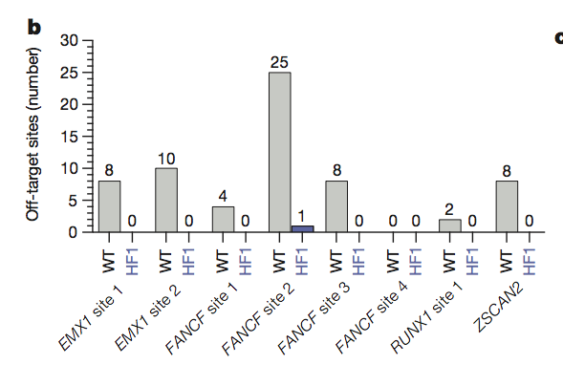
Genome wide analysis of off-target activity of ScCas9-HF1
Studies of the crystal structure of Streptococcus pyogenes (Sp-) Cas9 showed that that 4 amino acid residues of the protein (N497, R661, Q695, Q926) make non-specific contacts with the sugar-phosphate backbone of the DNA.
Joung and colleagues asked if the binding energy provided by these contacts could be eliminated without compromising the ability of the guide RNA to direct on-target cleavage—i.e. if the binding energy from non-specific association of Cas9 with DNA was less than needed to direct cleavage of the intended target site.
They constructed a quadruple mutant with the codons for the 4 binding residues changed to codons for alanine (alanine does not bind DNA).
This quadruple mutant form of Cas9, called SpCas9-HF1, shows near normal on-target cleavage efficiency and little or no off target cleavage.

Slide 25
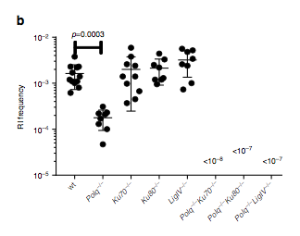
TMEJ and c-NHEJ are partially redundant pathways that promote “off-target” DNA knock-in events
Mutating the PolQ gene reduces off-pathway knock-in events.
Mutating a gene required for c-NHEJ, has no effect, but double mutants that
eliminate PolQ and a gene required for c-NHEJ (e.g. Ku80) completely eliminates off-target
knock-ins. BRAND NEW MAJOR BREAKTHROUGH.

Slide 26
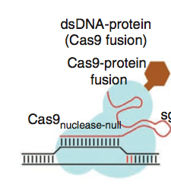
Other uses of CRISPR/Cas9
Mutant Cas9 protein defective in nuclease activity: Cannot make DSBs
Fuse Cas9 to transcription factor. Now transcription factor can be programed
by gRNA to bind any site of interest.
Any protein (or RNA) can be directed to bind any locus in the genome.
Uses:
Rewire any transcriptionally-regulated process by using a gRNA that directs Cas9 to the
promoter of interest.
“Light up” any site on the chromosome by fusion of a fluorescent protein to Cas9.
RNA
polymerase

Slide 27
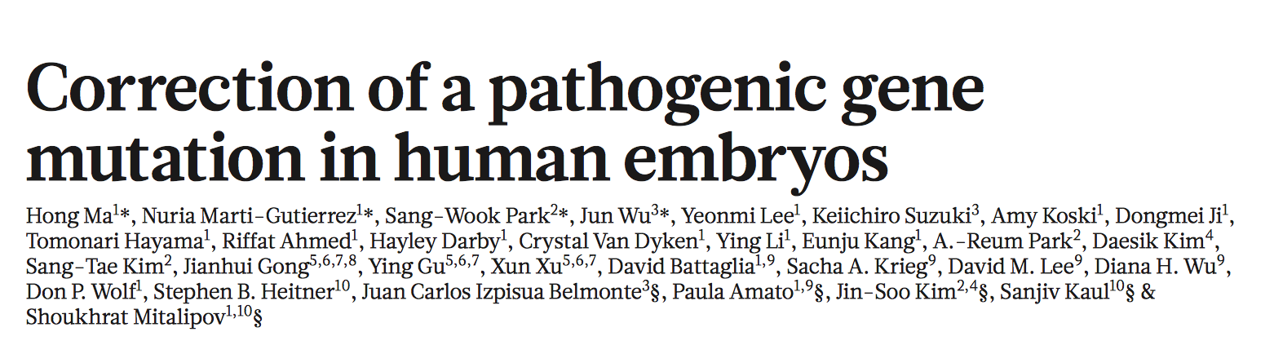
First report of using CRISPR to correct a human disease mutation in human embryo

Slide 28
Some major implications of CRISPR/Cas9
Now possible to genetically manipulate many types of human cells at will, including human zygotes. Makes it possible to correct disease mutation in pluripotent stem cells and even germ cells.
Also possible to engineer new functions in humans? Major ethical/legal issues will need to be addressed.
Reverse genetic methods in major model organisms (flies, plants, worms) have, until recently, often been limited to making transgenic organisms where the introduced DNA fragments are inserted at a random, or non-homologous, locus. These methods are rapidly becoming obsolete—i.e. the bar is being raised and the old methods may no longer “cut it” with journal reviewers.
Opinion: I believe that a trend will emerge wherein many important new genetic findings in model organisms will be expected to be accompanied by corresponding genetic results in human cells.

Slide 29
Saccharomyces cerevisiae
Domesticated by Man starting around 6000 BC
Baker’s yeast
Brewer’s yeast (same genus)
Budding yeast
Natural habitat: Tree Bark

Slide 30
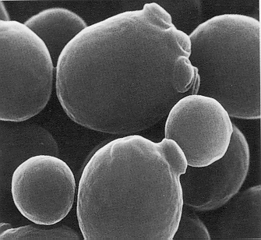
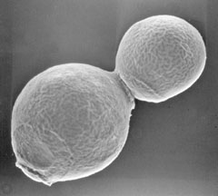
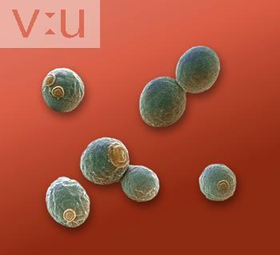
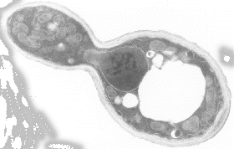
Growth by budding

Slide 31
Organism Profile: Saccharomyces cerevisiae
Short generation time (90-120 min)
Dispersed cells
Small genome (3X E. coli, 12 Mbp)
Eukaryote (nucleus, mitochondria, spindles, meiosis, etc.)
Inexpensive to grow
Non-pathogenic
Survives refrigeration and freezing!!

Slide 32
Organism Profile: Saccharomyces cerevisiae
Historically… the most easily modified genome.
Extremely high homologous targeting efficiency without the need to induce chromosomal DNA double strand breaks.
Advanced array of cloning vectors
It has long been possible to alter the genome quickly and at will.

Slide 33
Organism Profile: Saccharomyces cerevisiae
Favorable properties of Life cycle
Equivalent haploid and diploid phases
Direct screens for recessive mutants in haploids
Complementation tests in diploids
Recombination analysis via meiosis
All four product of meiosis recovered
Segregation analysis
Mapping
Strain construction
Identification of essential genes
Characterization of genetic suppressors
Allows details of the mechanism of homologous recombination to be revealed.

Slide 34
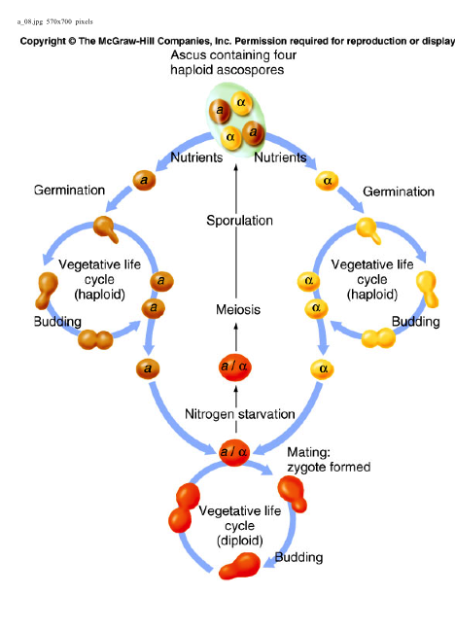
Life cycle
Key Features:
Stable vegetative growth as haploid or diploid.
Mate by mixing mixing haploid strains on growth medium.
Sporulation and meiosis by starvation of diploids.
Germination by placing spores on growth medium.

Slide 35
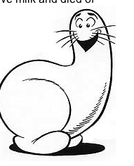
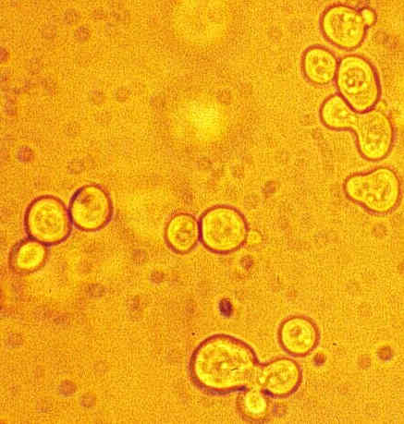
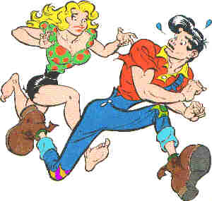
Yeast Mating
Zygote
Shmoo
Li’l Abner (1934-1977)
Al Capp
Zygote

Slide 36
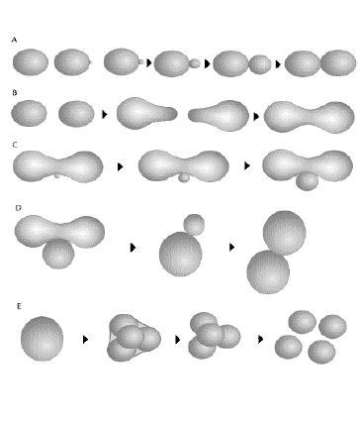
Yeast Life Cycle
large bud
(dumbell)
small bud
unbudded
budding cycle
shmoo
mating
zygote
Meiosis/sporulation
ascus
ascospores

